Slide 1
Fintech Incentive & Reward Optimization
End-to-End Data Analytics Project
Tools Used Python • SQL (MySQL) • Excel • Power BI
-Suraj Thakur

Slide 2
Agenda
01
Business Problem
04
Business Performance Overview
02
Objective of this project
05
Incentive & Referral Efficiency Analysis
03
Data Model & Metrics
06
Executive Insights & Recommendations

Slide 3
Business Problem Fintech platforms often use cashback and referral incentives to increase user engagement and transaction volume. However, excessive incentives can reduce profitability if the revenue generated does not offset the incentive costs.
Objective of this project:
• Analyze the impact of incentives on transaction growth • Evaluate referral program efficiency • Compare revenue generation with incentive spending • Identify profitability trends and key business insights

Slide 4
Data Model & Metrics
Dataset Overview
The dashboard integrates multiple datasets related to platform activity.
Tables used in the model:
• Transactions • Cashback payouts • Referral rewards • Users • Date dimension
Key Metrics Created
• Total Transactions • Successful Transactions • Total Revenue • Total Incentive Cost • Net Profit • Success Rate • Profit Margin
The data model enables cross-analysis between transaction activity, incentives, and profitability.

Slide 5
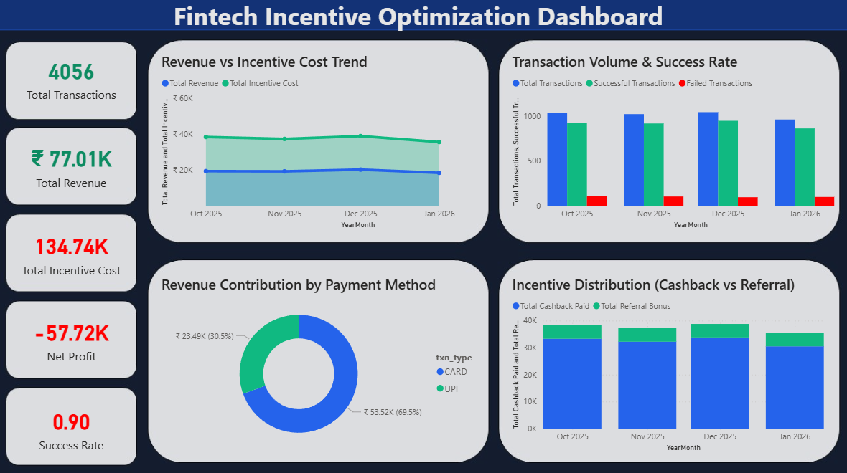
Business Performance Overview
This page provides a high-level overview of platform performance.
Key observations:
• The platform processed 4056 transactions during the period analyzed • Transaction success rate remains high at 90% • Total revenue generated is ₹77K • Incentive spending reached ₹134K
Insight
Incentive spending currently exceeds revenue generated, indicating a potential imbalance in the incentive strategy.

Slide 6
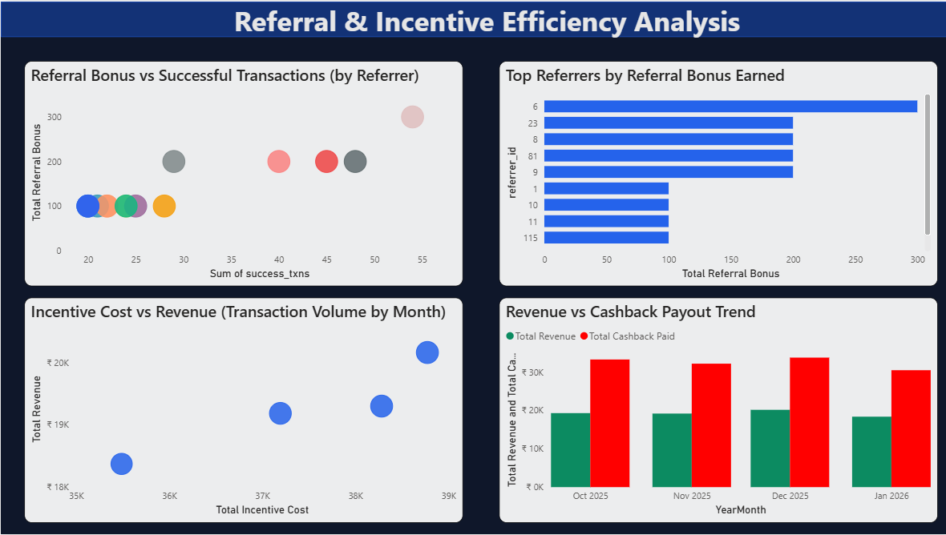
Incentive & Referral Efficiency Analysis
This section evaluates how incentives and referral programs influence platform activity.
Key analyses performed:
• Referral bonus impact on successful transactions • Top performing referrers by bonus earned • Relationship between incentive cost and revenue • Cashback payout trends across months
Insight
While incentives contribute to transaction growth, they significantly increase operational costs and require optimization.

Slide 7
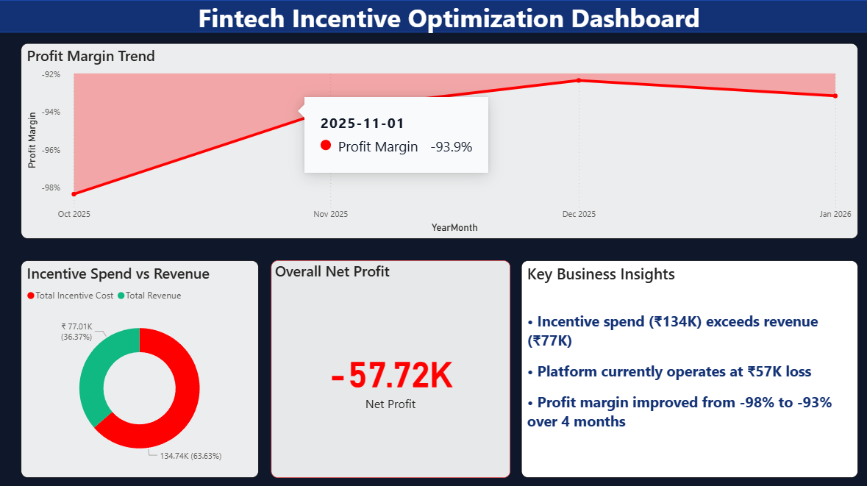
Strength Analysis
Key Insights
• Incentive spending (₹134K) exceeds total revenue (₹77K)
• The platform currently operates at a ₹57K net loss
• Profit margin improved slightly from -98% to -93% over four months
Recommendation
To improve profitability, fintech platforms should:
• Optimize cashback and referral incentives • Focus on high-value user segments • Balance growth incentives with sustainable revenue generation
This dashboard demonstrates how data analytics can help fintech platforms optimize incentive strategies while maintaining sustainable profitability.

Slide 8
Thank You

